Slide 1






Landing Pages
Creating Landing Page with HTML5 and CSS3
Landing Page
HTML5 + CSS3
SoftUni Team
Technical Trainers
Software University
http://softuni.bg

Slide 2
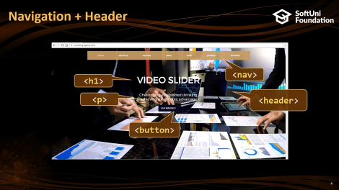

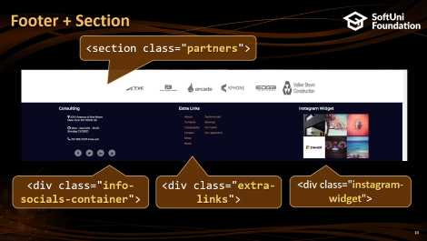

Table of Contents

Slide 3
Have a Question?
sli.do #front-end

Slide 4

Landing Page
What is a Landing Page?

Slide 5
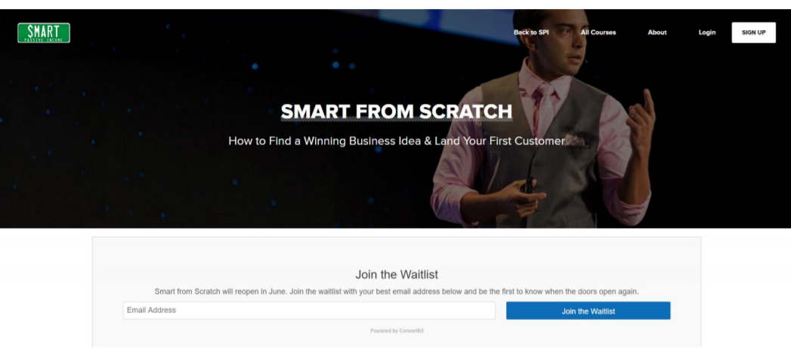
Landing Page
Serves as the entry point for a website or a particular section of a website
There are two types of landing pages
Reference
Transactional
Landing pages are used
for lead generation

Slide 6
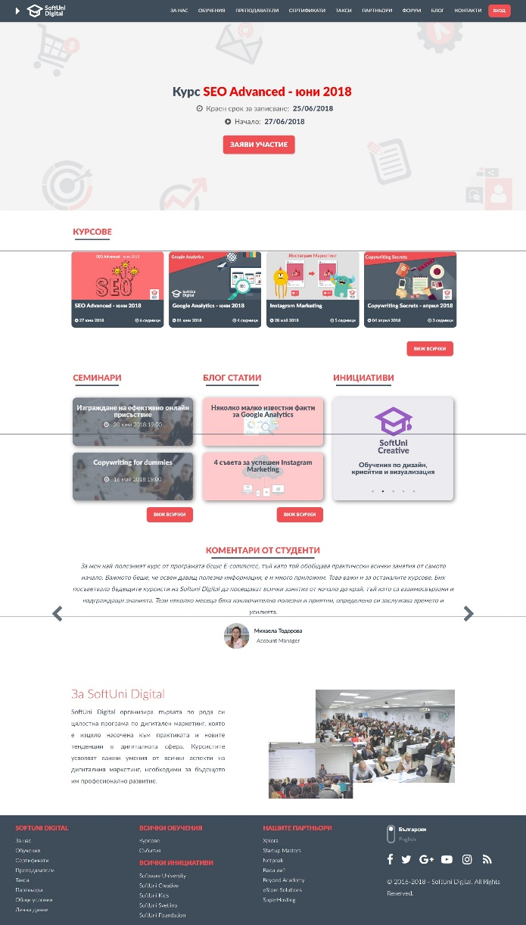

Landing Page
Objectives
Navigating visitors to the next stage in the buying journey
Types
lead generation page
click-through page

Slide 7
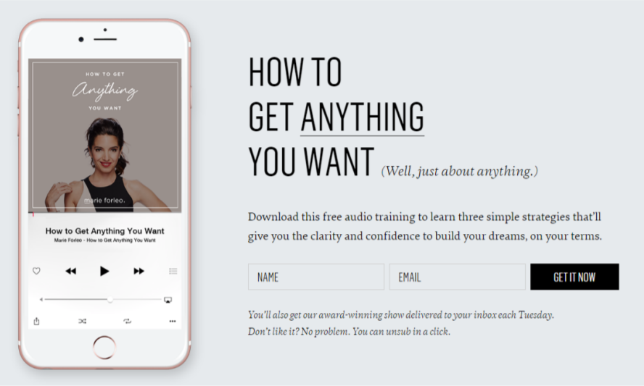
Special Types of Landing Pages
Signup Form
Sales Page
Home Page
Products Grid Page
Product Detail Page
Shopping Cart
Order Review

Slide 8


Building a Landing Page
Using HTML5 & CSS3

Slide 9
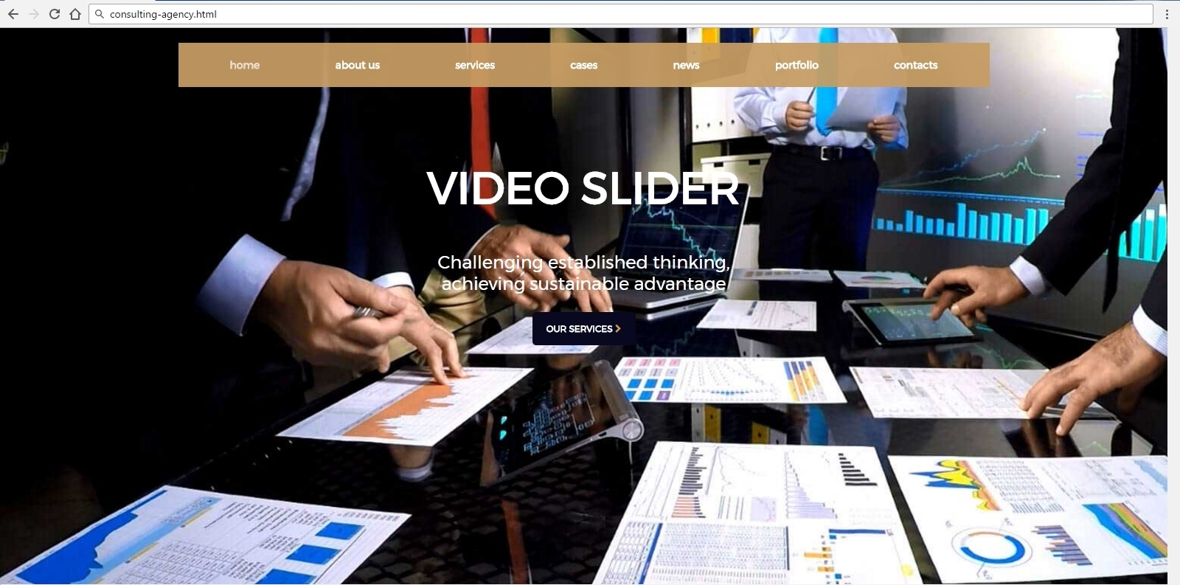
Navigation + Header
<nav>
<h1>
<p>
<header>
<button>

Slide 10
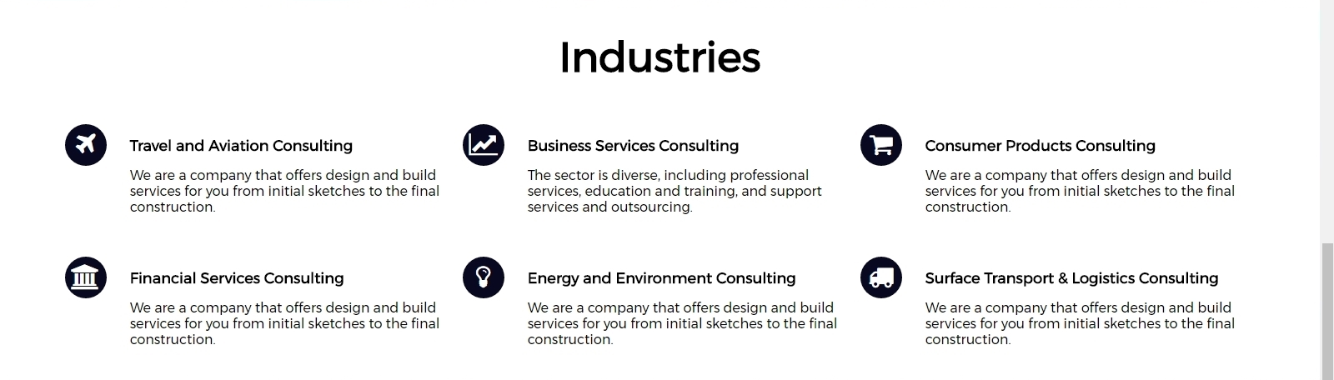
Main + Section
<section class="travel-business-customer">
<h2>
<section class="financial-energy-surface">

Slide 11

Main + Section
<section class="banner">
<section class="traders">

Slide 12
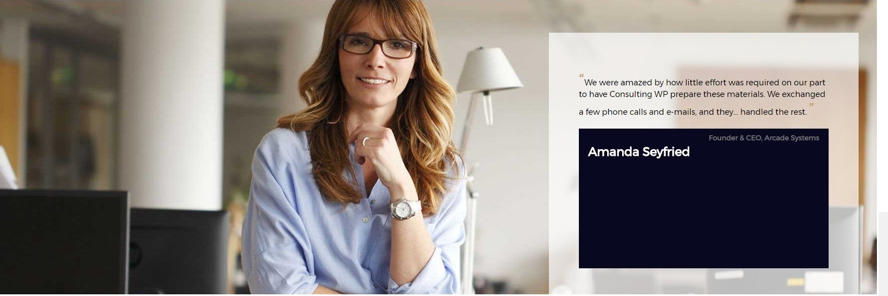
<section class="consulting-woman">
<article class="testimonial-info">

Slide 13
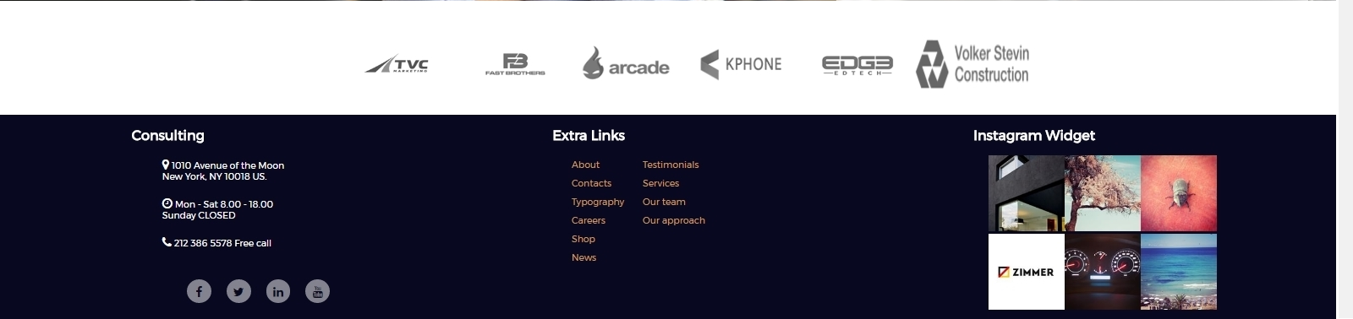
Footer + Section
<section class="partners">
<div class="info-socials-container">
<div class="extra-links">
<div class="instagram-widget">

Slide 14
Start with the HTML Page: agency.html
<!DOCTYPE html>
<html>
<head>
<title>Consulting Agency</title>
<link rel="stylesheet" href="agency.css">
</head>
<body>…</body>
</html>

Slide 15
Navigation + Header (HTML)
<header>
<nav>
<ul class="nav-primary">
<li class="nav-item home"><a href="#">home</a></li>
<li class="nav-item"><a href="#">about us</a></li>
<li class="nav-item"><a href="#">cases</a></li> <li class="nav-item"><a href="#">news</a></li>
<li class="nav-item"><a href="#">portfolio</a></li>
<li class="nav-item"><a href="#">contacts</a></li>
</ul>
</nav>
…

Slide 16
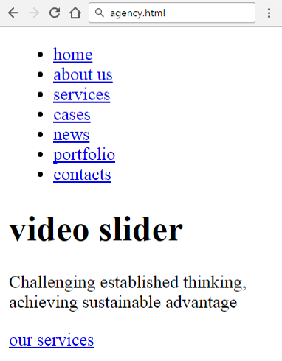
Header
<div class="consulting-rev">
<h1>video slider</h1>
<p>Challenging established…</p>
<a href="#">our services
<i class="fa fa-chevron-right"></i>
</a>
</div>
</header>

Slide 17
Navigation + Header (CSS)
@import url('https://fonts.googleapis.com/css?family=Montserrat');
@import url('https://maxcdn.bootstrapcdn.com/font-awesome/4.7.0/css/font-awesome.min.css');
body {
font-family: Montserrat, sans-serif;
font-size: 12px;
margin: 0;
padding: 0;
}

Slide 18
Navigation + Header (CSS)
body > header{
padding-top: 20px;
background: url('images/Layer-759_02.jpg') no-repeat;
background-size: cover;
height: 735px; }
nav, ul {
height: 60px;
list-style: none; }
nav {
background: rgba(199, 157, 99, .75);
width: 1100px;
margin: 0 auto; }

Slide 19
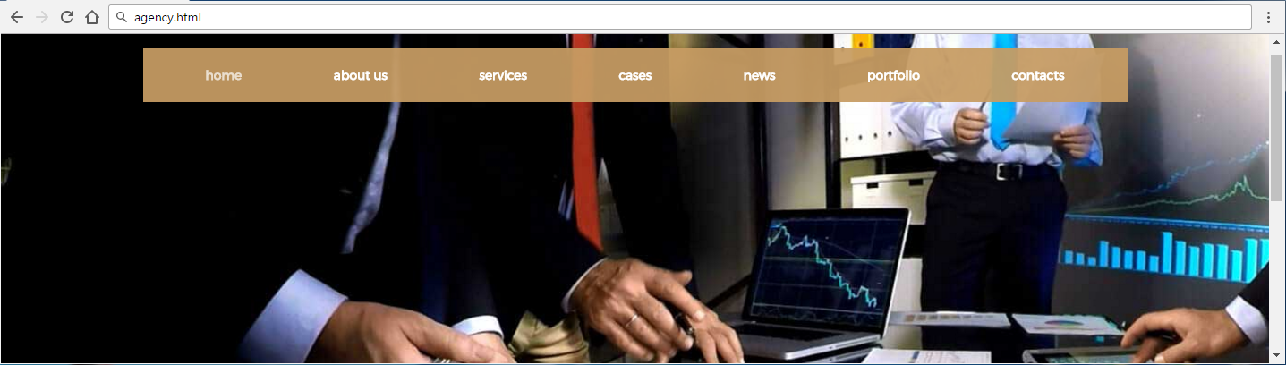
Navigation + Header (CSS)
nav ul.nav-primary {
background: rgba(199,157,99,0.75);
display: flex;
justify-content: center; }
.nav-item {
line-height: 60px;
margin: 0 70px 0 auto; }
.nav-item a {
color: #ffffff;
font-weight: 900;
text-decoration: none;
font-size: 14px;
}
.home.nav-item {
margin-left:30px; }
.home.nav-item a {
color: #ffffff;
opacity: 0.7; }
.consulting-rev {
width: 500px;
margin: 0 auto; }

Slide 20
Navigation + Header (CSS)
.consulting-rev h1 {
color: #ffffff;
font-size: 60px;
text-align: center;
margin-top: 100px;
margin-bottom: 50px;
text-transform: uppercase;
}
.consulting-rev p {
font-size: 24px;
color: #ffffff;
text-align: center;
}
.consulting-rev a {
margin: 20px auto;
display: block;
width: 120px;
height: 25px;
background: #090821;
padding: 10px;
line-height: 25px;
text-align: center;
border-radius: 5px;
color: white;
font-weight: 900;
text-decoration: none;
text-transform:uppercase; }

Slide 21
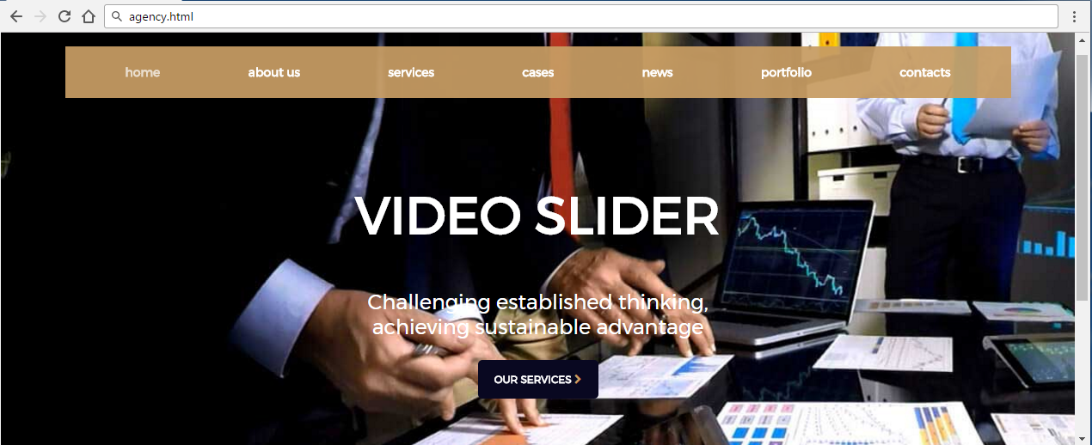
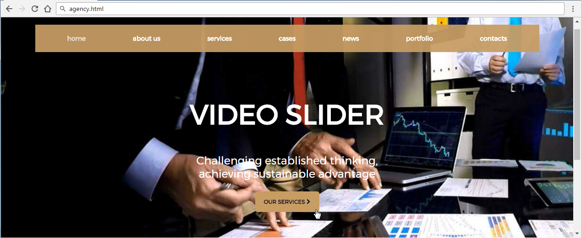
Navigation + Header (CSS)
.consulting-rev a:hover,
.consulting-rev a:hover
.fa-chevron-right
{
background: #c79d63;
color: #090821;
cursor: pointer;
}
.consulting-rev i
{
color: #c79d63;
}

Slide 22
Main (HTML)
<header>
<h2>Industries</h2>
</header>
<section class="travel-business-customer">
<div class="icon">
<i class="fa fa-plane" aria-hidden="true"></i>
</div>
<article>
<header>
<h2>Travel and Aviation Consulting</h2>
</header>
...

Slide 23
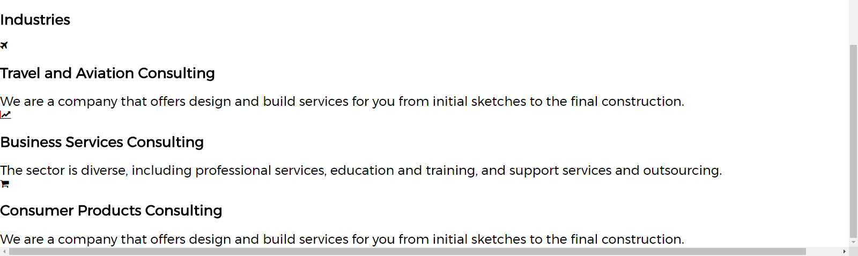
Main (HTML)
<p>We are a company that offers design…</p>
</article>
<!—TODO put the next two articles here-->

Slide 24
Main CSS
h2 {
text-align: center; }
section {
text-align: center;
margin-top: 50px; }
article {
width: 25%;
display: inline-block;
margin-left: 18px; }
main > header h2 {
text-align: center;
font-size: 50px;
margin-top: 40px; }
.icon
{
display: inline-block;
vertical-align: top;
font-size: 30px;
width: 50px;
height: 50px;
line-height: 50px;
background: #090821;
color: #fff;
border-radius: 50%;
margin-right: 7px;
}

Slide 25
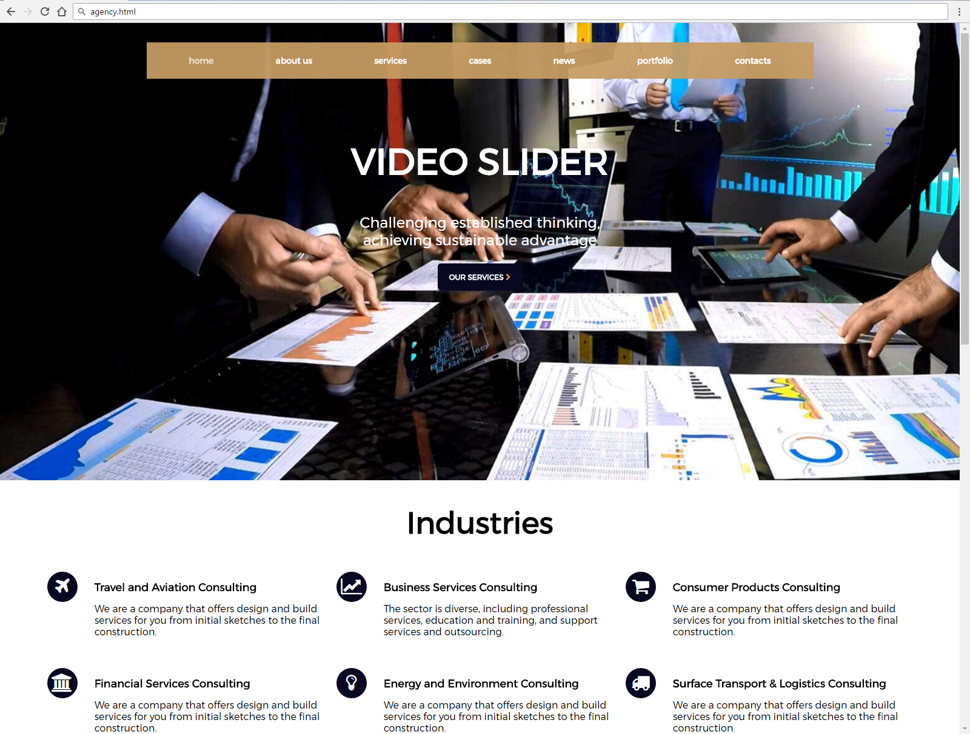
Main CSS
main p {
font-size: 16px;
margin: 10px 0 0;
text-transform: none;
color: #000;
text-align: left;
}
h2 {
text-align: left;
}

Slide 26
Main More HTML + CSS (.banner)
<section class="banner">
<h5>
<span>To help entrepreneurs get their act together</span>
before they talk to investors.
</h5>
</section>
h5 {
text-align: center;
font-size: 24px;
width: 520px;
margin: 0 auto;
}

Slide 27
Main CSS (.banner)
.banner span {
color: #c79d63; }
.banner {
margin-bottom: 0;
padding-top: 35px;
padding-bottom: 46px;
margin-top: 40px;
display: block;
position: relative; }
.banner::after {
content: "";
background-size: cover;
opacity: 0.3;
background: url(images/steel-bg.jpg) center center;
top: 0;
left: 0;
bottom: 0;
right: 0;
position: absolute;
z-index: -1; }

Slide 28
Main HTML (.traders)
<section class="traders">
<h2>Why Traders Choose Us</h2>
<div class="article-container">
<a href="#"><h4>Raw Spreads</h4>
<p>Receive premium pricing from Top…</p>
</a>
<a href="#"><h4><No Dealing Desk</h4>
<p>With Consulting WP you’ll…</p>
</a>
<a href="#"><h4>State of the Art</h4>
<p>Trade Forex and CFDs with the world’s…</p>
</a>
</div>
<section>

Slide 29

Main CSS (.traders)
.traders {
margin: 0;
padding-top: 35px;
padding-bottom: 46px;
background: linear-gradient(rgba(0,0,0,0.6),rgba(0,0,0, 0.6)),
url('images/background-choose-us.jpg') no-repeat center;
background-size: cover;
}
.traders h2 {
text-align: center;
font-size: 40px;
color: #ffffff;
margin-bottom: 20px;
}

Slide 30
Main CSS (.traders)
.article-container {
display: flex;
justify-content: center; }
.article-container a {
margin-right: 30px;
padding: 20px;
width: 300px;
border: 2px solid #c79d63;
text-align: center;
text-decoration: none; }
.article-container a:hover,
.article-container a:hover p,
.article-container a:hover h4{
background: #fff;
color: #090821; }
.article-container h4 {
color: #fff;
margin: 0 0 17px 17px;
padding-top: 21px;
letter-spacing: 0;
font-size: 20px; }
.article-container p {
margin: 0 0 17px 17px;
font-size: 13px;
line-height: 18px;
color: #ffffff; }

Slide 31



Main CSS (.traders)

Slide 32

Main HTML (.consulting-woman)
<section class="consulting-woman">
<article class="testimonial-info">
<p>We were amazed by how little effort…</p>
<footer>
<h4>Amanda Seyfried</h4>
<p><strong>Founder & CEO…</strong></p>
</footer>
</article>
</section>

Slide 33
Main CSS (.consulting-woman)
.consulting-woman {
background-image: url("images/consulting-woman.jpg");
background-size: cover;
background-repeat: no-repeat;
height: 600px;
margin: 0;
position: relative; }
.testimonial-info {
position: absolute;
top: 70px;
right: 40px;
width: 500px;
padding: 64px 60px 53px 60px;
background: rgba(255, 255, 255, .7); }

Slide 34
Main CSS (.consulting-woman)
.testimonial-info > p::before,
.testimonial-info > p::after {
content: open-quote;
color: #c79d63;
font-size: 32px; }
.testimonial-info > p::after {
content: close-quote; }
.testimonial-info footer {
margin-top: 20px;
text-align: left; }
.testimonial-info footer h4 {
font-size: 24px;
}
.testimonial-info footer p {
padding: 0;
margin-bottom: 0;
font-size: 14px;
color: #777777; }
footer {
height: 280px;
background: rgb(9, 8, 33);
display: flex;
flex-direction: row;
justify-content:space-around;
color: #ffffff
}

Slide 35

Main CSS (.consulting-woman)

Slide 36

Main HTML (.partners)
<section class="partners">
<ul>
<li>
<a href="#">
<img src="images/partner-TVC.png" alt="TVC Marketing">
</a>
</li> <!—TODO put the
rest list items here…-->
</ul>
</section>
</main>

Slide 37

Main CSS (.partners)
.partners {
height: 90px;
margin-top: 45px; }
.partners ul {
display: flex;
justify-content: center; }
.partners img {
width: 135px;
height: 60px;
}

Slide 38

Footer Section HTML (info-social-container)
<footer class="footer">
<div class="info-socials-container">
<h2>Consulting</h2>
<ul class="info">
<li><i class="fa fa-map-marker"></i>1010 Avenue of …</li>
<li><i class="fa fa-clock-o"></i>Mon-Sat 8.00-18.00…</li>
<li><i class="fa fa-phone"></i>212 386 5578 Free call</li>

Slide 39
Footer Section HTML (info-social-container)
<li>
<ul class="socials">
<li><a href="#"><i class="fa fa-facebook"></i></a></li>
<li><a href="#"><i class="fa fa-twitter"></i></a></li>
<li><a href="#"><i class="fa fa-linkedin"></i></a></li>
<li><a href="#"><i class="fa fa-youtube"></i></a></li>
</ul>
</li>
</ul>
</div>

Slide 40
Footer Section CSS (info-social-container)
footer h2 {
color: #ffffff;
margin-left: 20px;
padding-top: 10px;
}
.info li {
color: #ffffff;
width: 180px;
margin-top: 20px;
margin-left: 20px; }
.info li i {
font-size: 16px; }
.socials {
display: flex;
justify-content: center;
width: 153px; }
.socials li {
width: 200px; }
.socials a {
display: block;
width: 32px;
font-size: 18px;
line-height: 32px;
text-align: center;
border-radius: 50%;
background: rgb(131,131,143);
color: #090821;
}

Slide 41

Footer Section CSS (info-social-container)

Slide 42
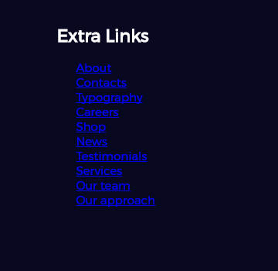
Footer Section HTML (extra-links)
<div class="extra-links">
<h2>Extra Links</h2>
<ul>
<li><a href="#">About</a></li>
<li><a href="#">Contacts</a></li>
<li><a href="#">Typography</a></li>
<li><a href="#">Careers</a></li>
<li><a href="#">Shop</a></li>
<!—TODO put the rest list items here-->
</ul>
</div>

Slide 43
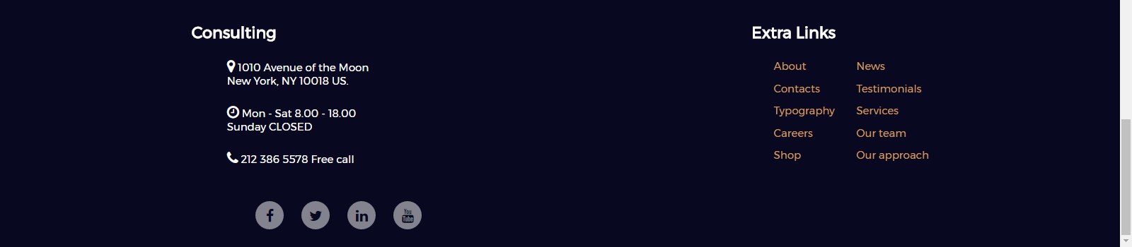
Footer Section CSS (extra-links)
.extra-links ul {
display: flex;
flex-wrap: wrap;
flex-direction: column;
height: 148px;
width: 200px; }
.extra-links ul li {
display: block;
padding: 5px;}
.extra-links ul li a {
color: #c79d63;
text-decoration: none; }

Slide 44
Footer Section HTML (instagram-widget)
<div class="instagram-widget">
<h2>Instagram Widget</h2>
<ul>
<li><a href="#"><img src="…/footer-widget(1).jpg"></a></li>
<li><a href="#"><img src="…/footer-widget(2).jpg"></a></li>
<li><a href="#"><img src="…/footer-widget(3).jpg"></a></li>
<li><a href="#"><img src="…/footer-widget(4).jpg"></a></li>
<li><a href="#"><img src="…/footer-widget(5).jpg"></a></li>
<li><a href="#"><img src="…/footer-widget(6).jpg"></a></li>
</ul>
</div>

Slide 45
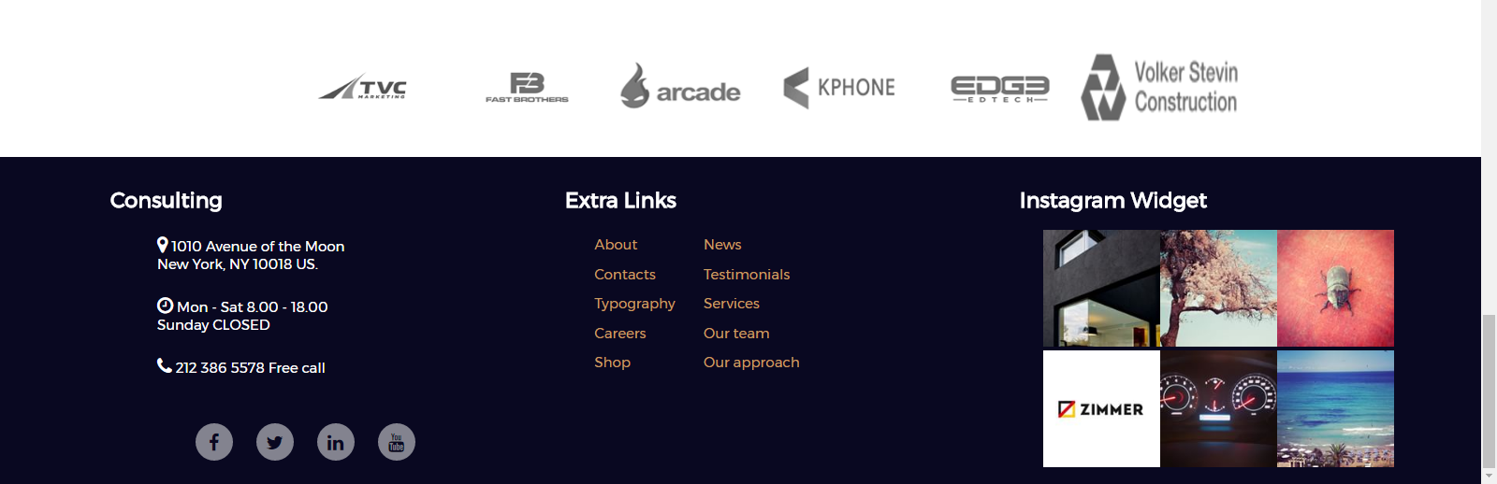
Footer Section CSS (instagram-widget)
.instagram-widget ul {
display: flex;
flex-direction: row;
flex-wrap: wrap;
width: 300px; }
.instagram-widget img
{
width: 100px;
height: 100px;
}

Slide 46

Summary
What is a Landing Page?
Entry point for a website
Landing Page Objectives
Types of Landing Pages
Building a landing page
Using HTML5 & CSS3
Building each element separately

Slide 47







Web Fundamentals – Course Introduction
https://softuni.bg/courses/web-fundamentals-html5

Slide 48






SoftUni Diamond Partners

Slide 49






SoftUni Diamond Partners

Slide 50
License
This course (slides, examples, demos, videos, homework, etc.) is licensed under the "Creative Commons Attribution-NonCommercial-ShareAlike 4.0 International" license

Slide 51





Trainings @ Software University (SoftUni)
Software University – High-Quality Education, Profession and Job for Software Developers
softuni.bg
Software University Foundation
http://softuni.foundation/
Software University @ Facebook
facebook.com/SoftwareUniversity
Software University Forums
forum.softuni.bg

